Slide 1
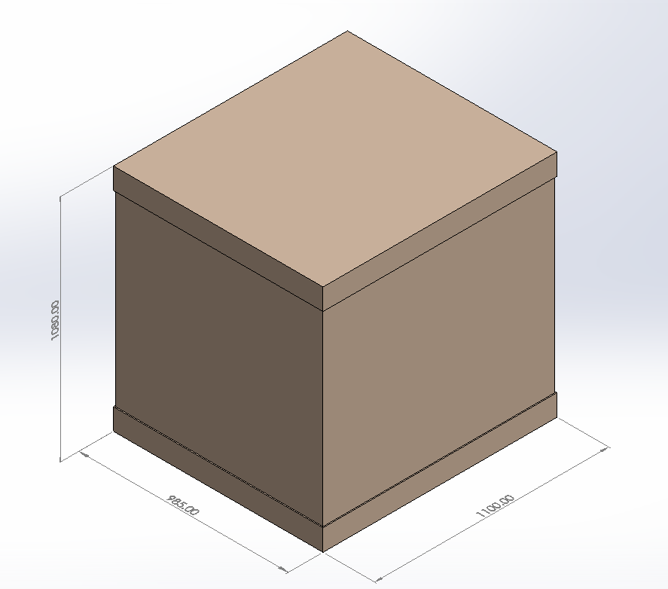
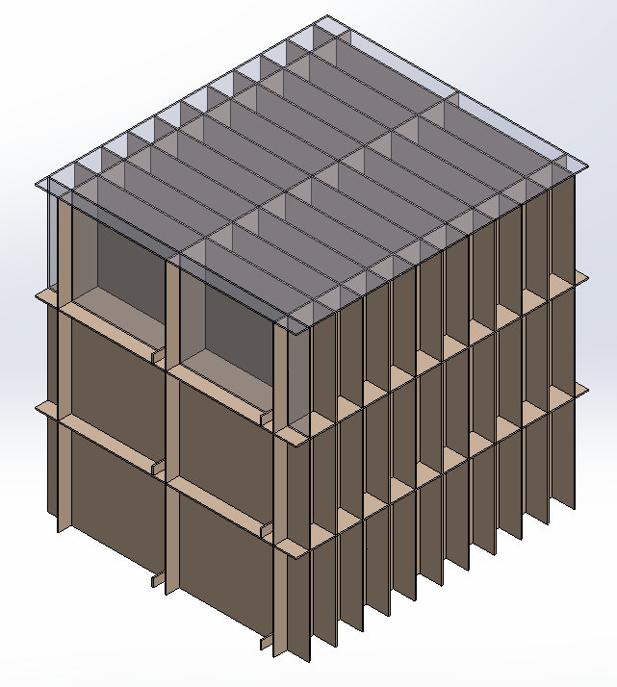
Box Partition Group B
OD: 985x1100x1080 mm

Slide 2
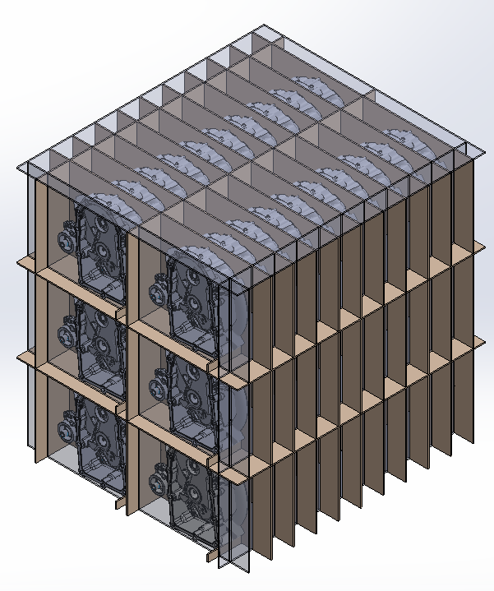
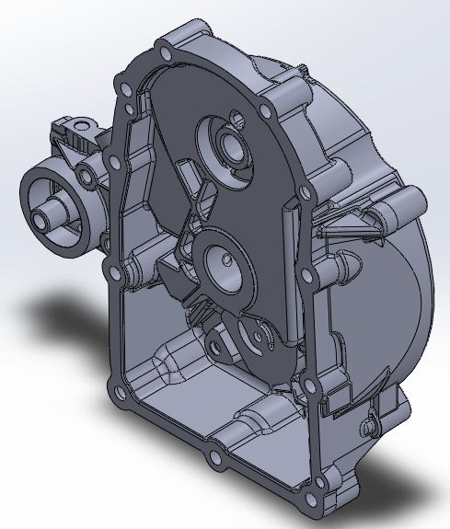
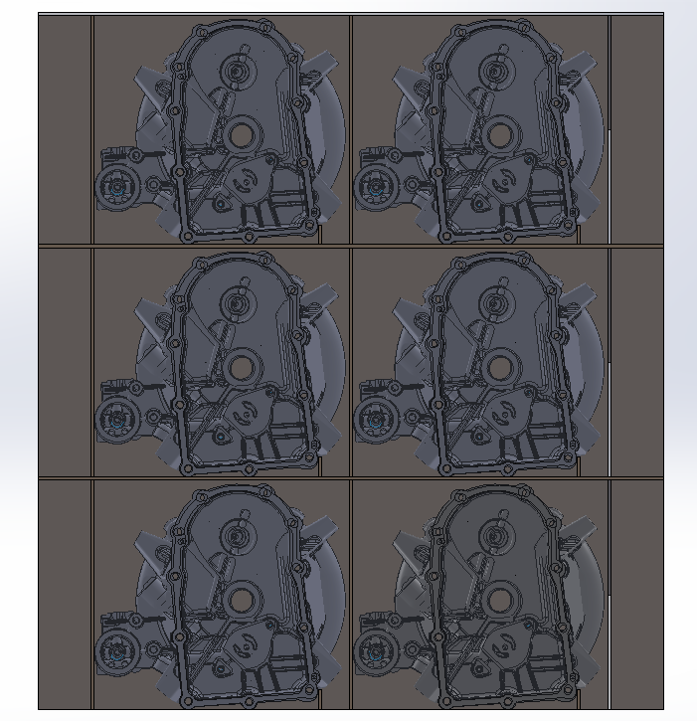
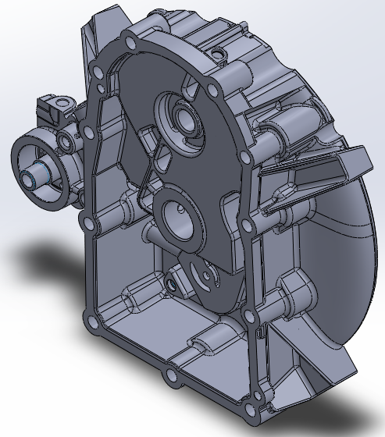
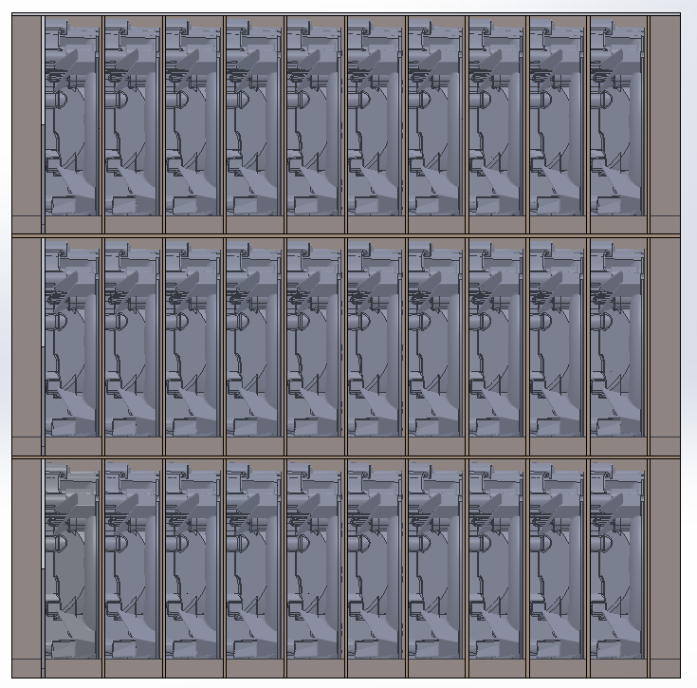
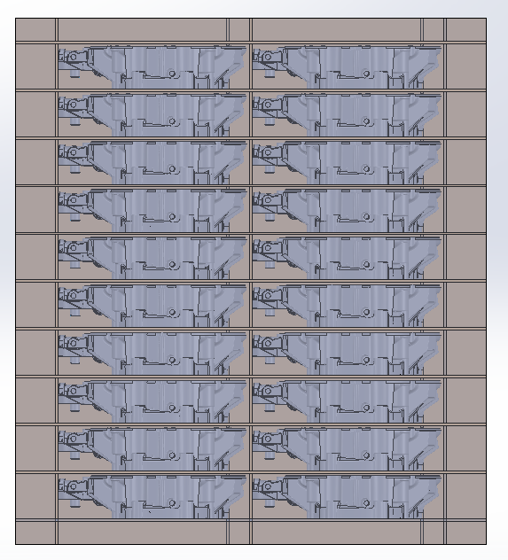
Front
SNP
20 Pcs/Layer
60 Pcs/ Set
Part Weight
4.22 kg/Pcs
20 pcs = 84.4 kg
60 pcs = 253.2 kg
Right
Top

Slide 3
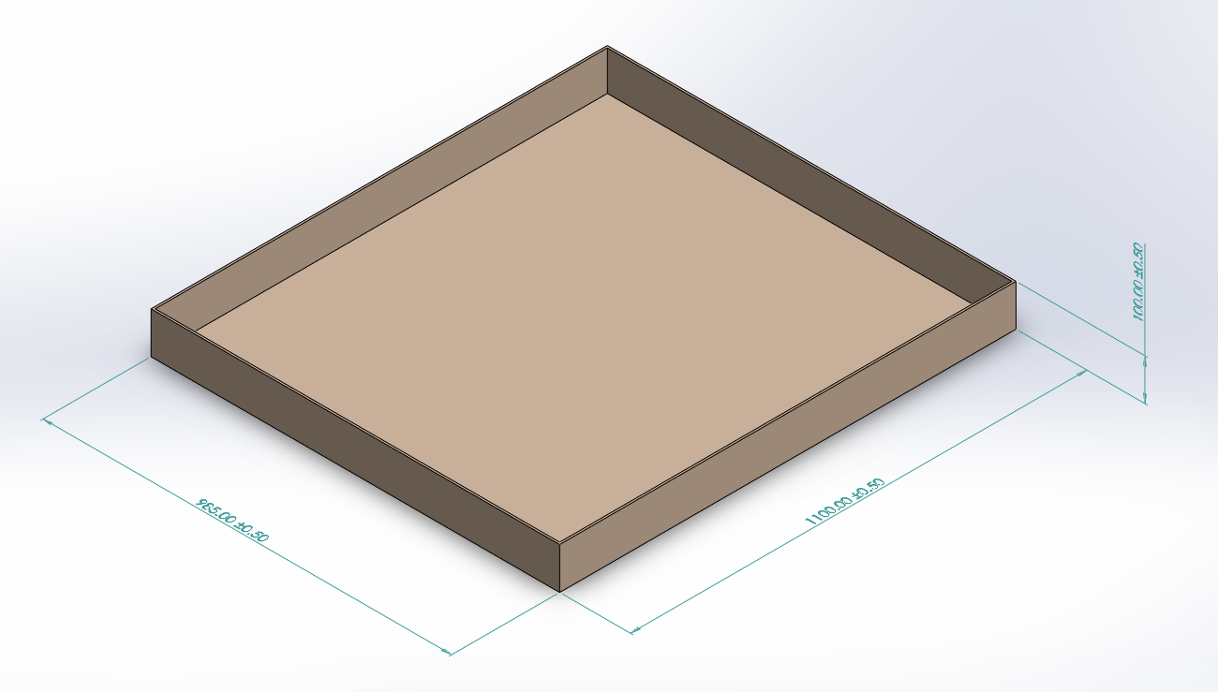
Cap
OD: 985x1100x100 mm
Lon: BC
2 pcs/set

Slide 4
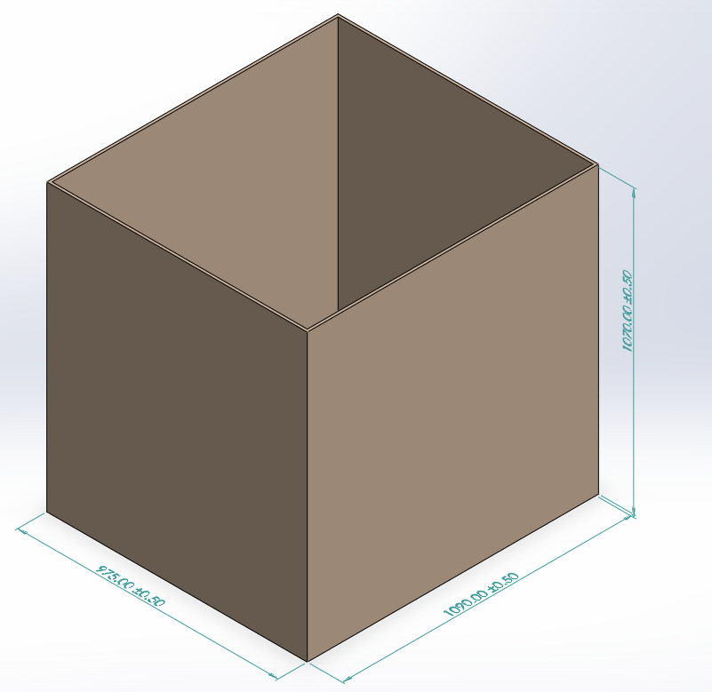
Sleeve
OD: 975x1090x1070 mm
Lon: BC+BC
1 pcs/set

Slide 5
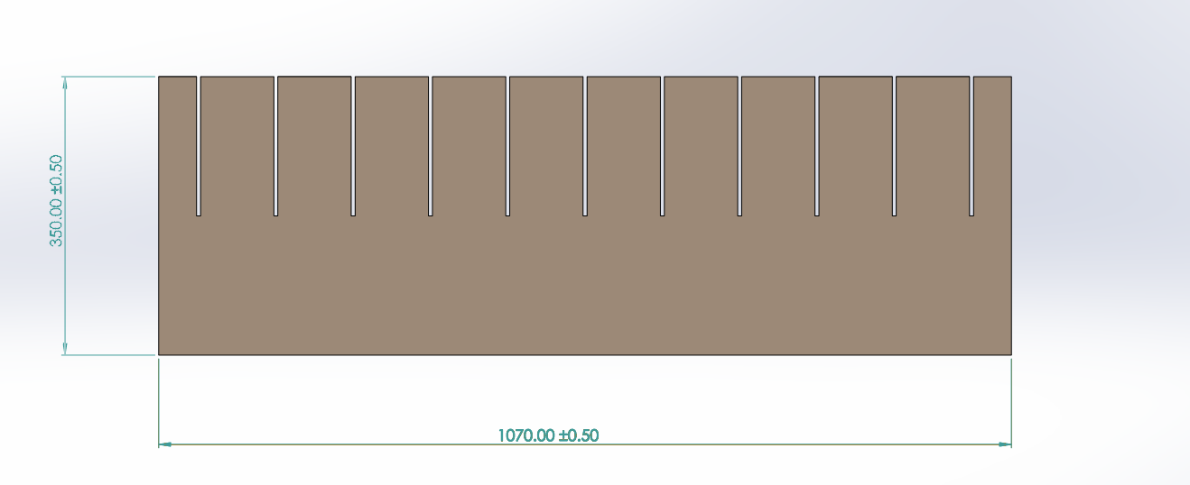
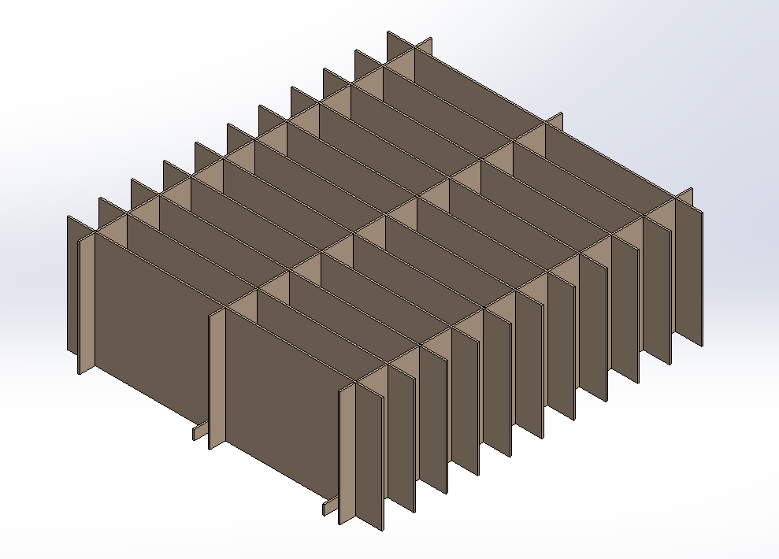
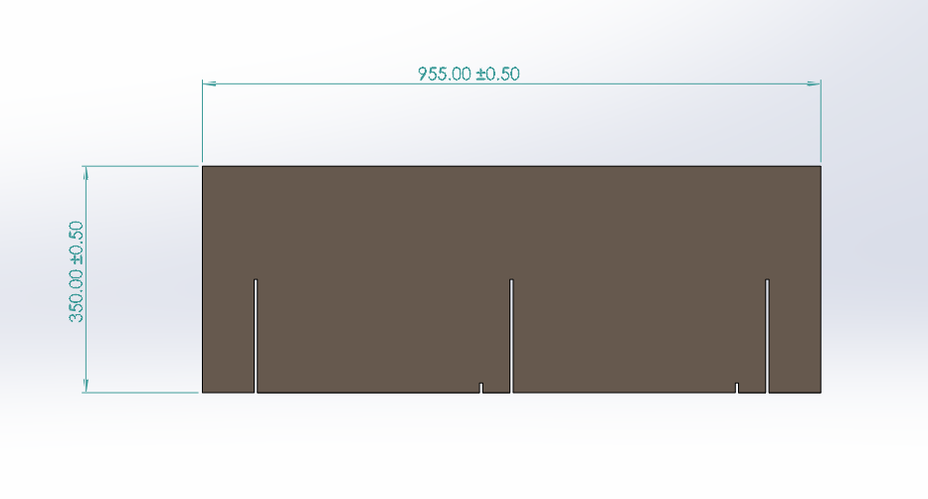
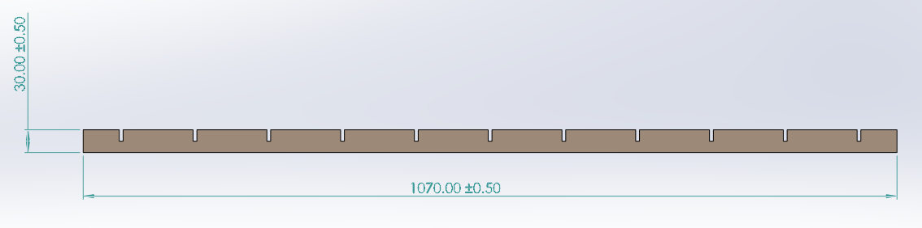
Partition A 350x1070 mm
Lon: BC
3 pcs/Layer
9 pcs/set
Partition B 350x955 mm
Lon: BC
11 pcs/Layer
33 pcs/set
Partition C 30x1070 mm
Lon: BC
2 pcs/Layer
6 pcs/set

Slide 6
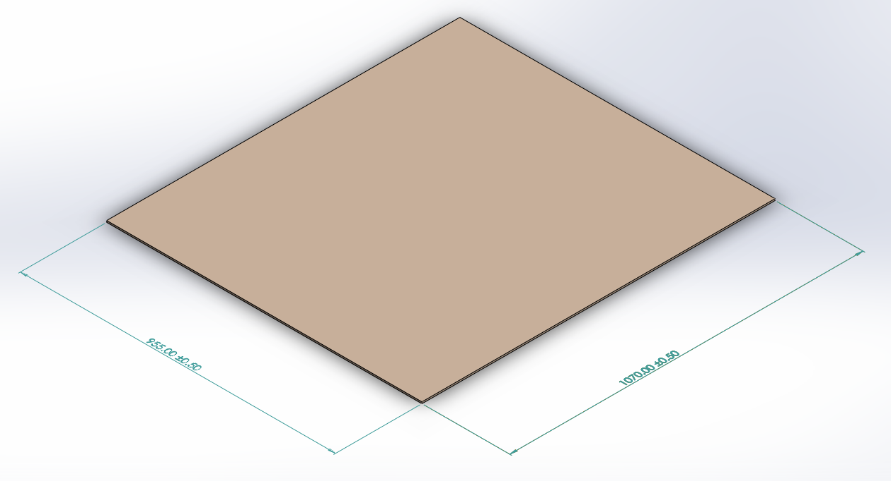
Pad
OD: 955x1070 mm
Lon: BC
3 pcs/set

