Slide 1
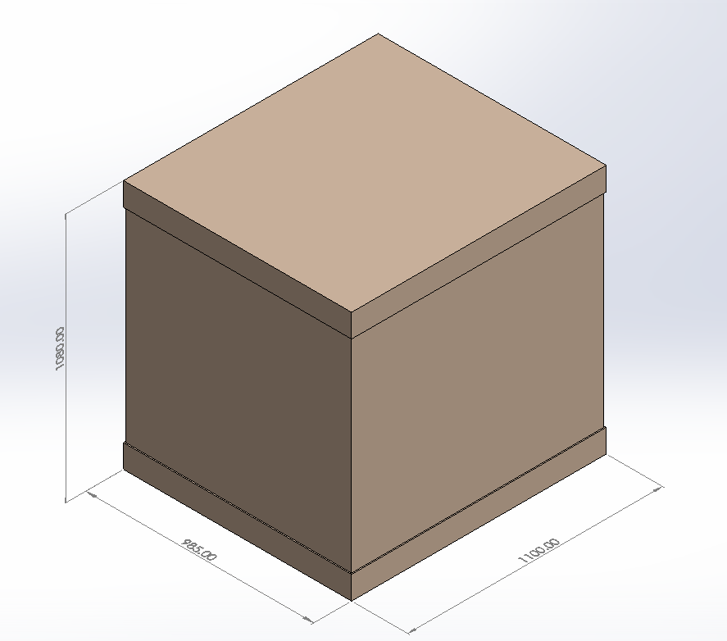
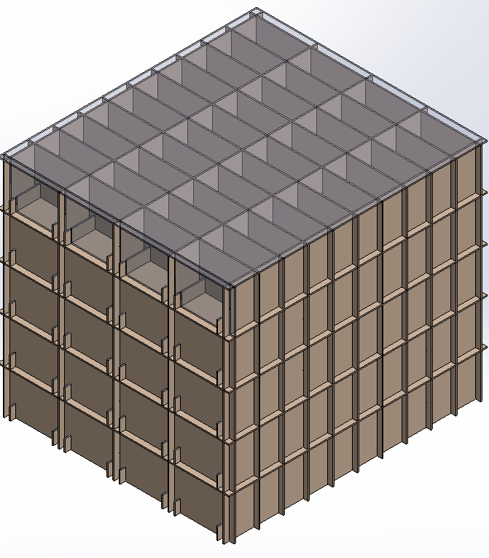
Box Partition Group A
OD: 985x1100x1080 mm

Slide 2
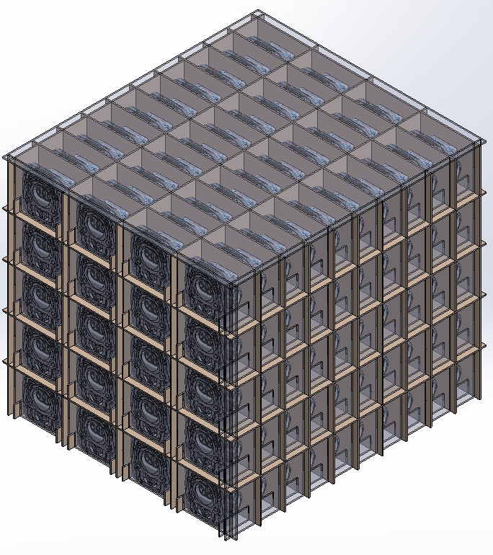
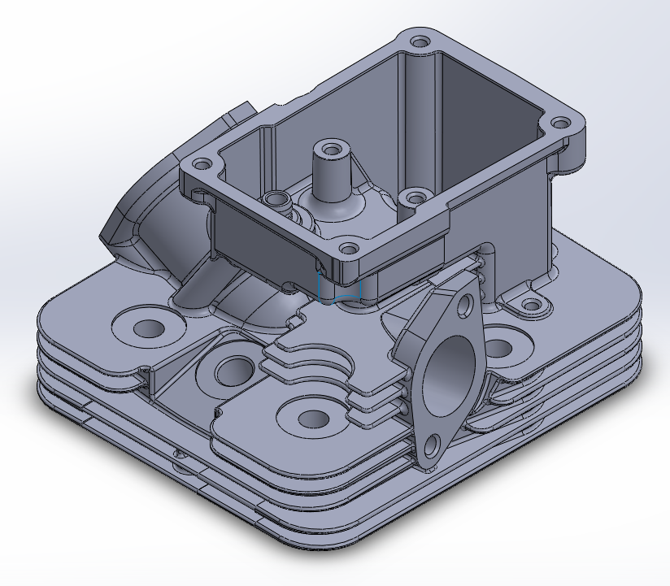
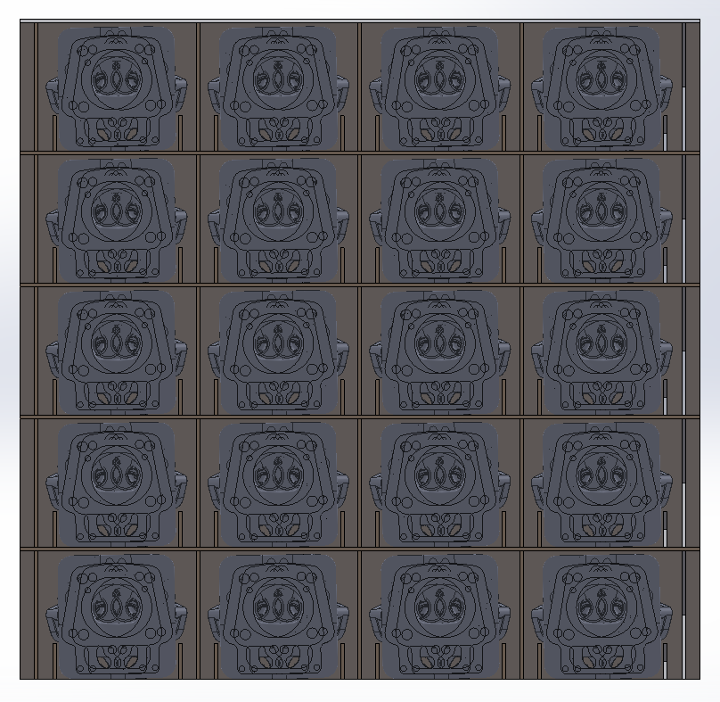
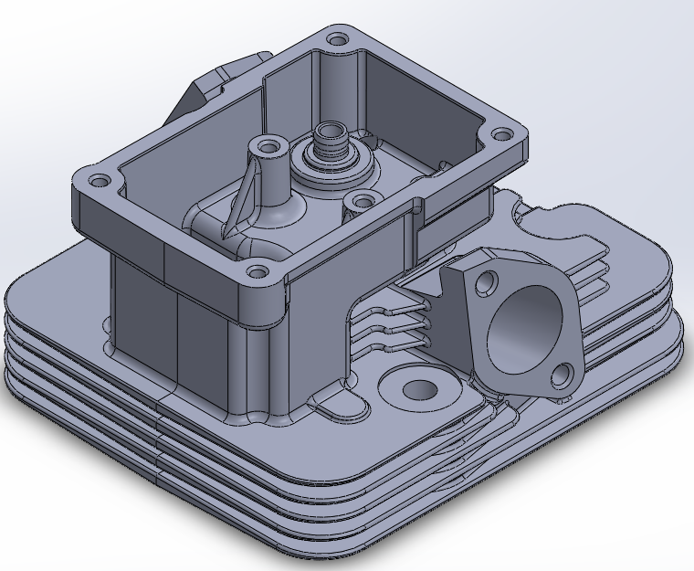
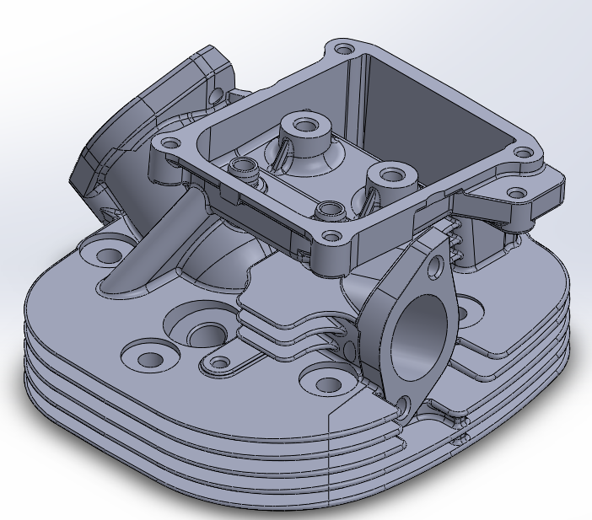
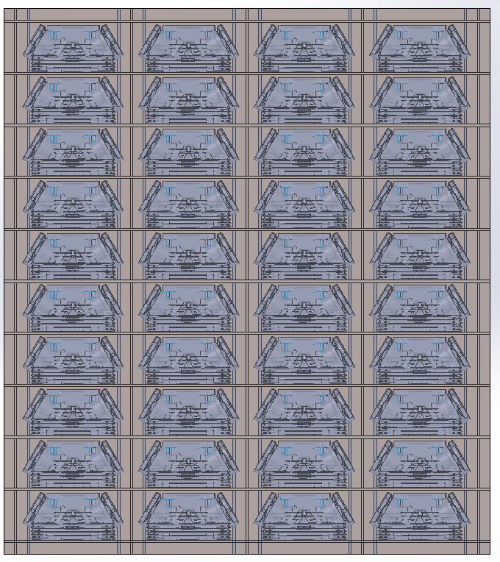
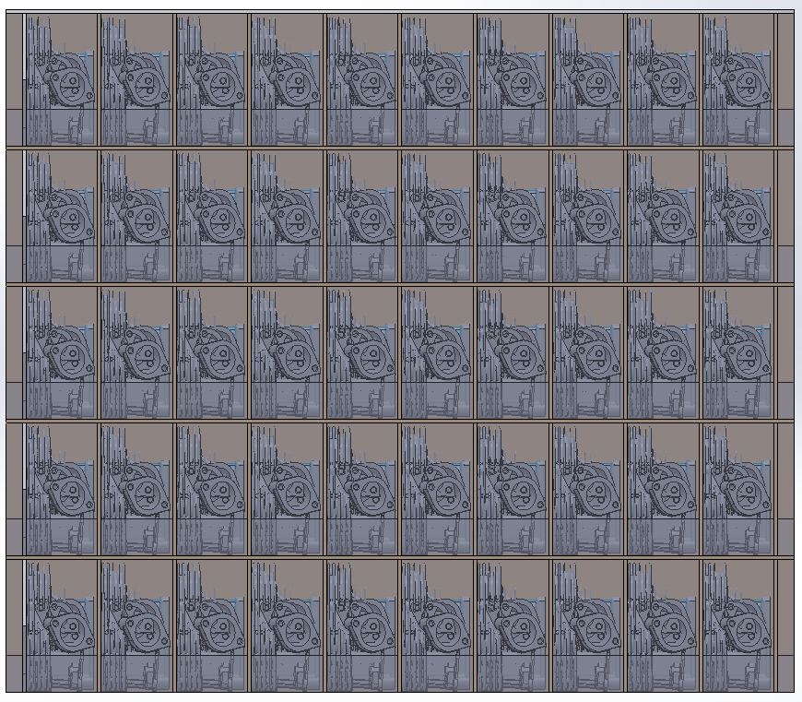
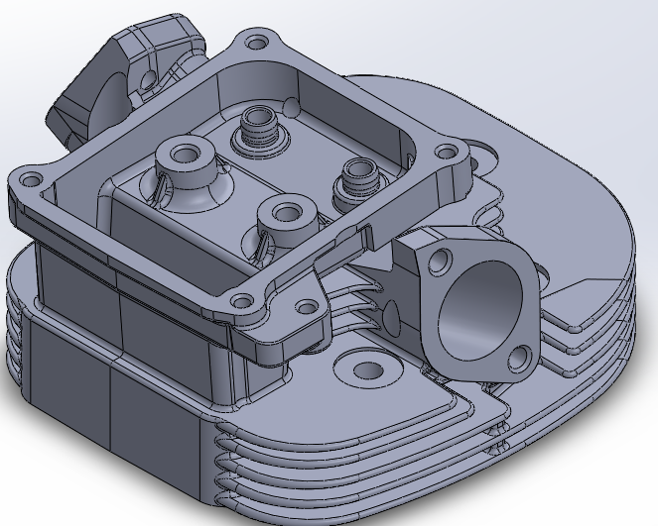
Front
SNP
40 Pcs/Layer
200 Pcs/ Set
Part Weight
1.87 kg/Pcs
40 pcs = 74.8 kg
200 pcs = 374 kg
Right
Top

Slide 3
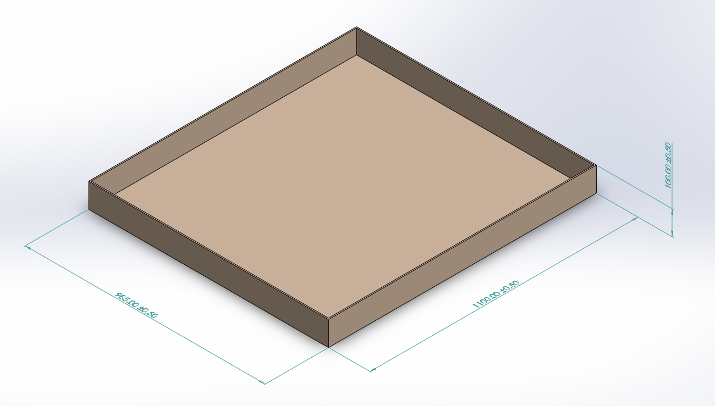
Cap
OD: 985x1100x100 mm
Lon: BC
2 pcs/set

Slide 4
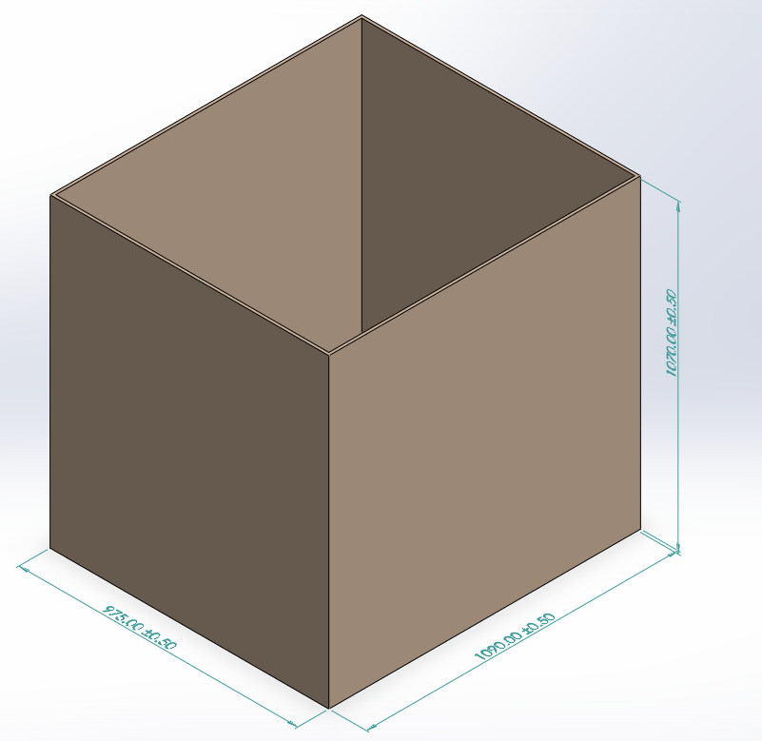
Sleeve
OD: 975x1090x1070 mm
Lon: BC+BC
1 pcs/set

Slide 5
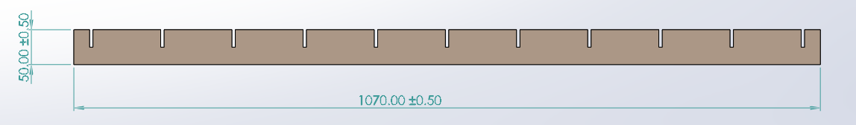
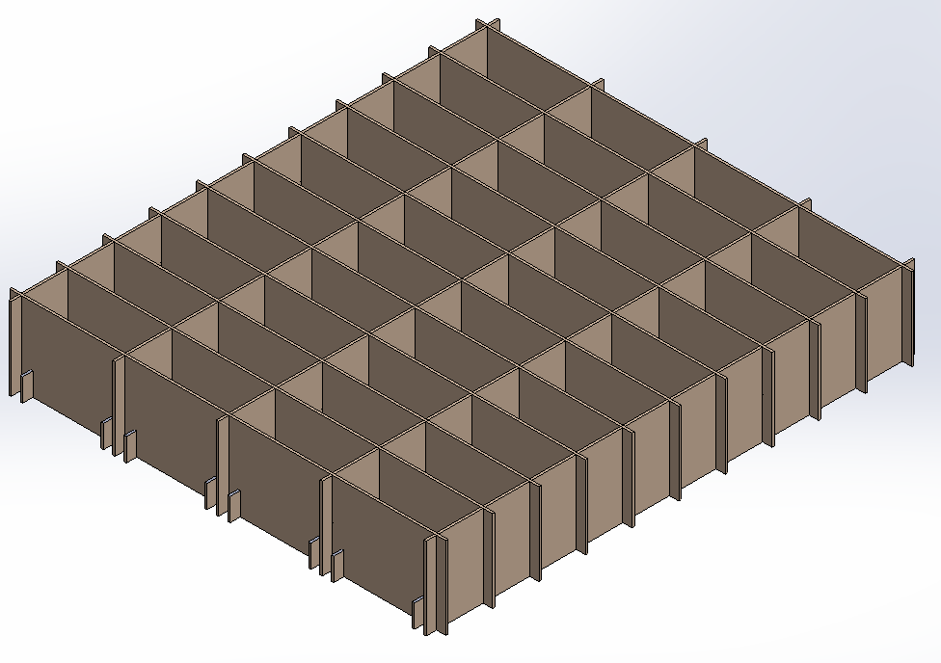
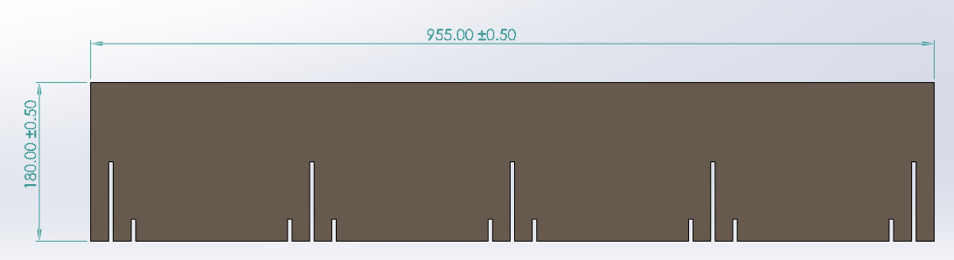
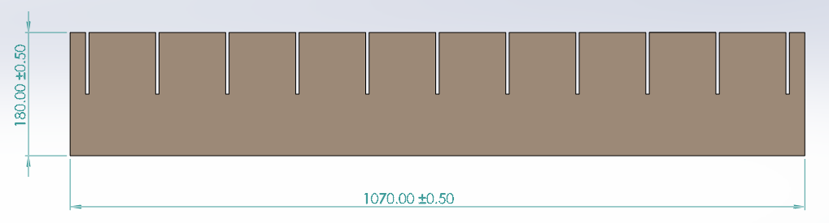
Partition A 50x1070 mm
Lon: BC
8 pcs/Layer
40 pcs/set
Partition B 180x955 mm
Lon: BC
11 pcs/Layer
55 pcs/set
Partition C 180x1070 mm
Lon: BC
5 pcs/Layer
25 pcs/set

Slide 6
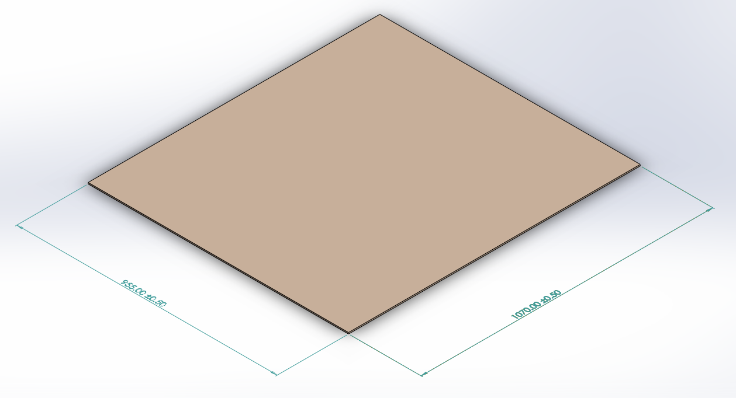
Pad
OD: 955x1070 mm
Lon: BC
5 pcs/set

